Slide 1


MongoDB for Developers
Ben Galluzzo
www.bengalluzzo.com
ben_galluzzo@yahoo.com
@BenGalluzzo
bengalluzzo@otterbits.com
Code Camp NYC - 2016

Slide 2
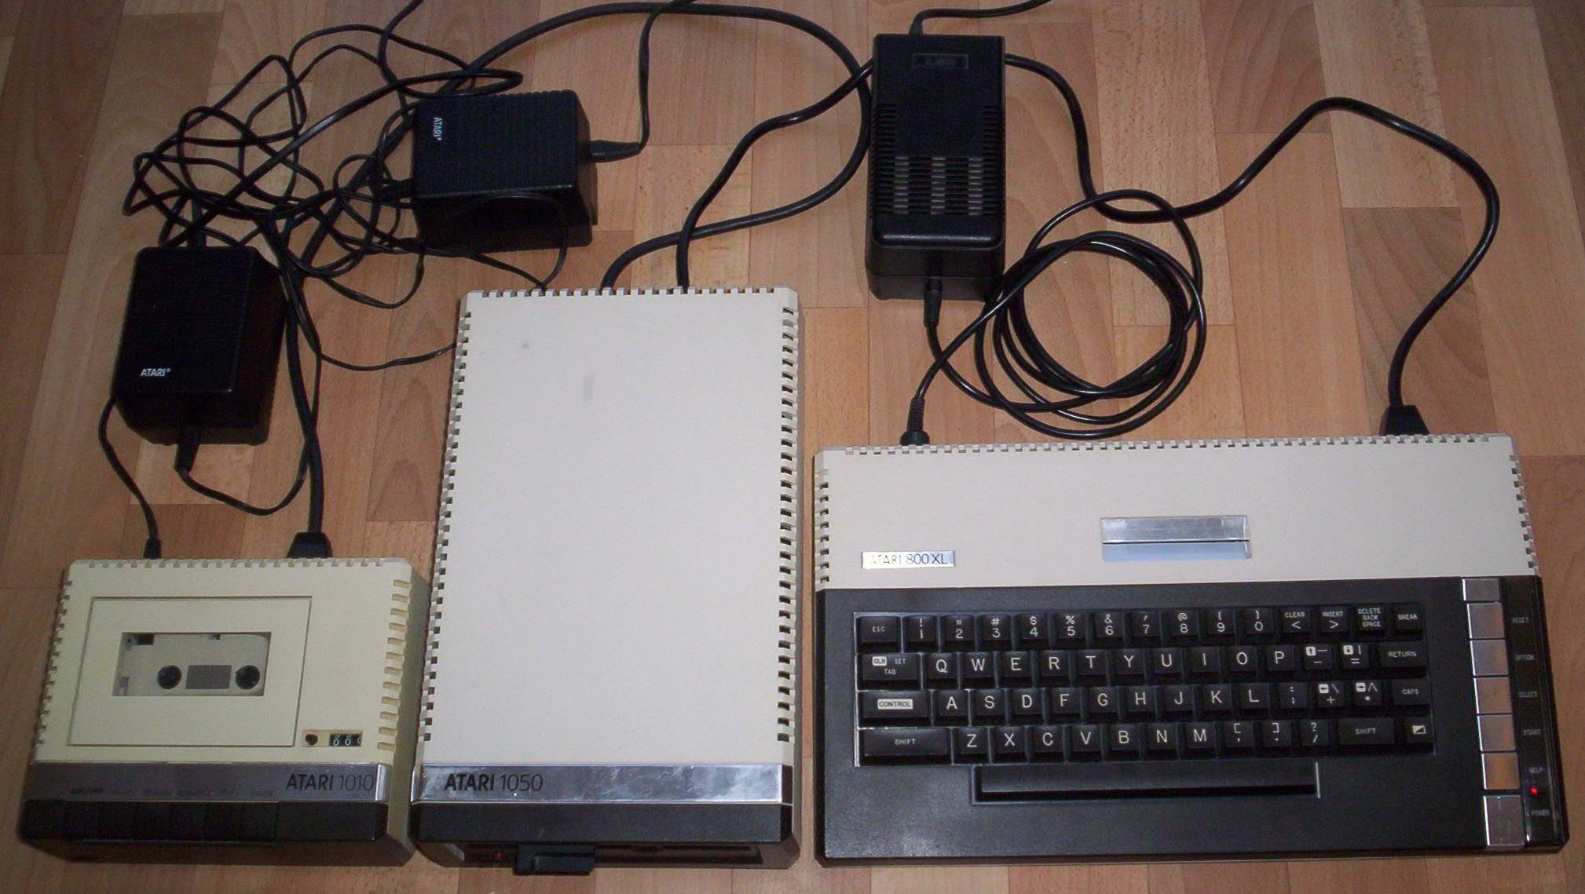
Introduction

Slide 3
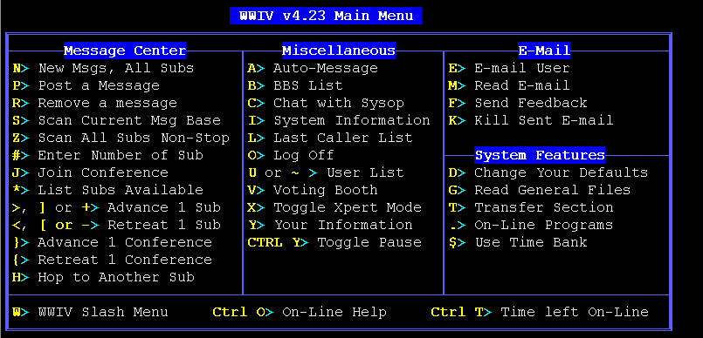
Introduction

Slide 4

MongoDB Introduction

Slide 5
MongoDB for SQL Developers
MongoDB Overview
MongoDB to SQL terminology
MongoDB Operations
MongoDB Operations (demo)
Development environment overview
SSIS - MongoDB to SQL Server (demo)
SSIS - Disparate Documents (demo)
Resources

Slide 6
MongoDB Overview
What is MongoDB?
  Open Source
  Document Oriented Database
  Uses BSON “Binary JSON” format
  Multi-platform

Slide 7
MongoDB Overview
Who uses MongoDB
  Weather Channel
  ADP
  Expedia
  SourceForge
  Bosch

Slide 8
MongoDB Overview
Features of MongoDB
  document-oriented database
  not strongly typed (structure not enforced)
  server-side JavaScript execution
  interoperates nicely with applications (JSON)
  offers load balancing (multiple servers)

Slide 9
MongoDB Overview
Reasons for using MongoDB (or NoSQL)
  High amount of data having low value
    Social networking comments
    Log data
  Document Storage
  Cached Data
  Unstable Schema

Slide 10
MongoDB to SQL Terminology
MongoDB | SQL
database | database
collection | table
document | record (row)
field | column
linking/embedded documents | join
primary key (_id field) | primary key (user designated)
index | index

Slide 11
MongoDB Operations
INSERT
  db.<collectionName>.insert( { .... } )
SELECT
  db.<collectionName>.find()
UPDATE
  db.<collectionName>.update( { .... } )
DELETE
  db.<collectionName>.remove( { .... } )

Slide 12
MongoDB Operations
DEMO

Slide 13
Development Environment Overview
MongoDB
MongoDB CSharp driver
Register driver dll’s
Visual Studio BIDS/SSDT

Slide 14
SSIS - MongoDB to SQL Server
DEMO

Slide 15
SSIS – Disparate Documents
DEMO

Slide 16
Resources
MongoDB Utilities
  MongoVue
    http://simplybusiness.github.io/mongosis/
  RoboMongo
    http://robomongo.org/
MongoDB SSIS Components
    Mongosis
      http://simplybusiness.github.io/mongosis/

Slide 17
Additional Resources
Installing MongoDB
  Installation Package
    http://www.mongodb.org/downloads
  Installation Notes
    http://docs.mongodb.org/manual/tutorial/install-mongodb-on-windows/
CSharp Driver (v1.8.3)
  https://github.com/mongodb/mongo-csharp-driver/releases?after=v1.9.2
BIDS/SQL Server Data Tools (SSDT)
  For Visual Studio 2012
    https://www.microsoft.com/en-us/download/details.aspx?id=36843
  SSDT Notes
    https://msdn.microsoft.com/en-us/data/tools.aspx

Slide 18



Professional Groups

Slide 19











Thanks to our Sponsors
Marquee Sponsor
Platinum Sponsor
Silver Sponsor
Contributing Vendor

Slide 20


Thanks to our Volunteers

Slide 21
MongoDB for Developers
Ben Galluzzo
www.bengalluzzo.com
ben_galluzzo@yahoo.com
@BenGalluzzo
bengalluzzo@otterbits.com
Code Camp NYC - 2016

